Slide 1
Econ 100 Principles of Economics
Lecture 22
May 22

Slide 2
Production and growth
Assignment 9 this Friday, related to unemployment

Slide 3
Production and Growth

Slide 4
Economic growth: the last 2000 years

Slide 5
Until 1500, there had been almost zero growth of output per worker.
After 1800, we see large sustained increases in worldwide standards of living.
population growth accelerated
output per capita grew

Slide 6
The Growth before Industrial Revolution
Neolithic revolution, the transition to farming and settlement after about 9000 BC: the most significant technological revolution of all times; increased productivity and the development of socially and politically more complex societies.
Ancient Greek society from 800 BC to 50 BC: consumption per capita doubled
Roman republic after 400 BC
Pre-Columbian civilizations, Olmec, the Maya, the Aztec
FACT: None of the above led to a sustained growth.
6

Slide 7
The characteristics of these earlier growth episodes
Earlier episodes were relatively short-lived and in slow-pace.
Growth has never based on continuous technological innovations.
Economic institutions necessary to support sustained growth did not develop.
All these episodes took place within the context of authoritarian political regimes.
They were not broad-based growth experiences. This was elite-driven growth.
7

Slide 8
Why did the world economy not experience sustained growth before 1800?
In these earlier episodes, growth must always rely on existing techniques and production relationships. It will not unleash the process of creative destruction and the entry of new talent and new businesses necessary for the sustained growth.
e.g. “Verdict: If a cloth weaver intends to process a piece according to his own invention, he must not set it on the loom, but should obtain permission from the judges of the town to employ the number and length of threads that he desires.” France, 1666
No reward system (rather punishment)
No idea of personal gain: In Shakespeare’s time, the object of life for the ordinary citizen was not to advance his station in life, but to maintain it.
8

Slide 9
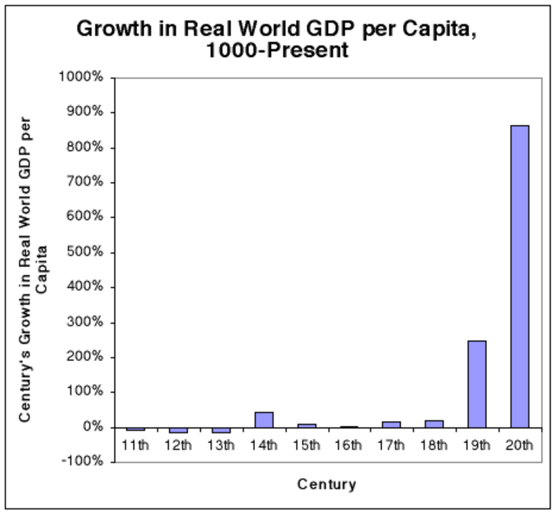
Economic takeoff started around 1800 and in Western Europe
9

Slide 10
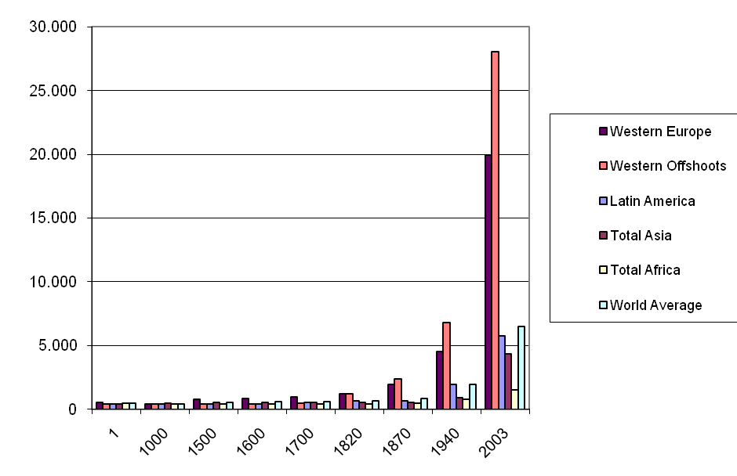
World GDP selected years
10

Slide 11
Western offshoots: Australia, New Zealand, Canada and the United States
These four countries have experienced much more rapid growth since 1820 than Western Europe or the rest of the world. Between 1820 and 2001 their combined population increased 35–fold, compared with less than 3–fold in Western Europe. Their GDP increased 679–fold compared with 47–fold in Western Europe. Average per capita GDP (in terms of 1990 international dollars) rose from $1,202 to $26,943; Western Europe’s from $1,204 to $19,256.
11

Slide 12
Why did economic takeoff start around 1800 and in Western Europe?
Collapse of the ancient regime, the decline of feudal relations
Enclosure: 17th century (competitive land market)
Serfs freed from their feudal dues.
Urbanization and changes in social relations
More importantly: it created the labor force ready to work at cheap wages in industrial and commercial activities (competitive labor market).
With the decline in population, real wages increased and large markets for merchants increased.
New products, new technologies: a platform for entrepreneural activities
Participatory regimes: political power shifted to a large group from a small monarchial elite
Securization of property rights and growth enhancing institutions
12

Slide 13
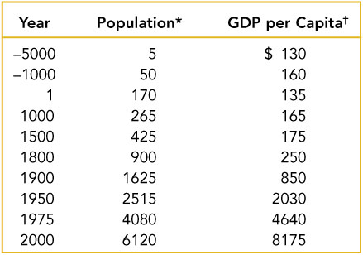
LONG TERM Economic Growth

Slide 14
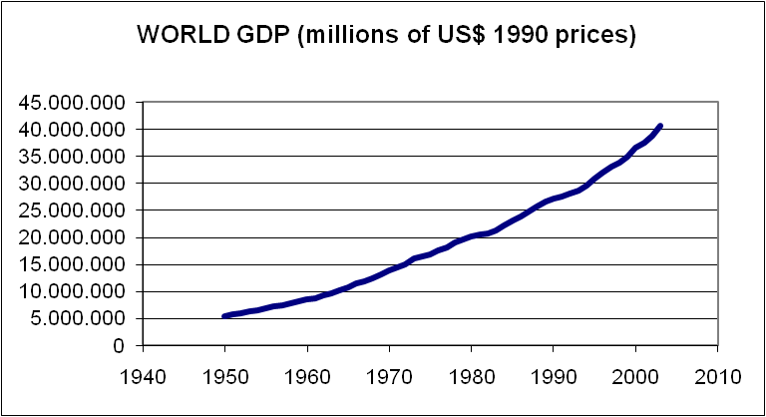

Slide 15
Advanced economies 60.47 thousand
ASEAN-5 3.37 thousand
Emerging market and developing econ. 45.1 thousand
Euro area 15.07 thousand
European Union 17.82 thousand
Major advanced economies (G7) 45.92 thousand
Middle East and Central Asia 4.65 thousand
Other advanced economies 8.86 thousand
Sub-Saharan Africa 2.1 thousand
World 105.57 thousand

Slide 16
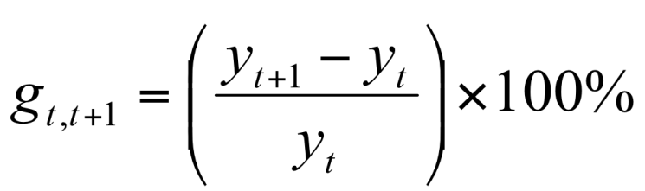
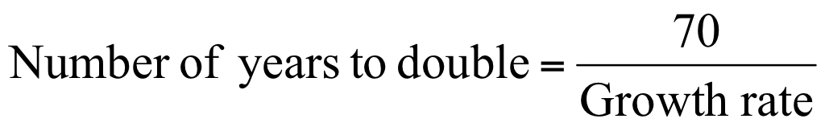
Growth Rates and the Rule of 70
Growth rate from one year to the next
If we assume that the growth rate is constant, then
16

Slide 17
Growth Rates and the Rule of 70
If per capita GDP grows at 7%, then it doubles every 10 years.
If per capita GDP grows at 2%, then it doubles every 35 years.
If real GDP per capita doubles every 10 years, most people in the country see significant increases in their living standards over the course of their lives.
If real GDP per capita doubles only every 100 years, then the increase in living standard is much lower.

Slide 18
The US

Slide 19

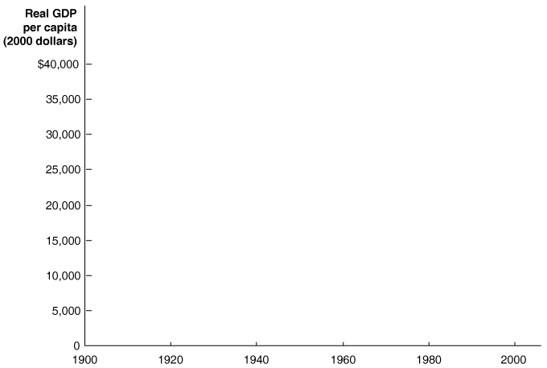
US; per capita GDP, 1900 to 2006

Slide 20
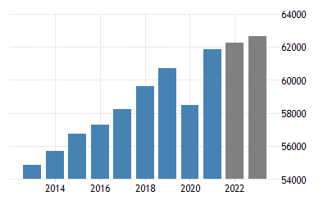
U.S. GDP per capita and 2022-2023 Forecast

Slide 21
Living standards in USA in 1900 were not high.
USA in 1900 was a poor country by today’s standards.
Notes:
21

Slide 22
USA in year 1900
Life expectancy at birth was less than 50 years.
More than 95 percent of all births took place at home.
About 1 in 10 children were dying before their first birthday.
The top three leading causes of death were pneumonia and influenza, tuberculosis, and diarrhea.
6% of people graduated from high school.
3% of homes had electricity.
15% of homes had indoor flush toilets.
Notes:
22

Slide 23
Turkey

Slide 24


Slide 25
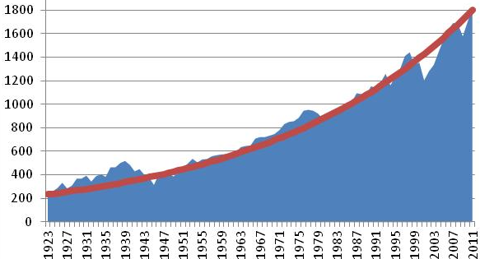
GDP per capita TURKEY in constant 1948 prices source: “İSTATİSTİK GÖSTERGELER” – Statistical Indicators, 1923-2011, TUIK publication number 3890
In 1923 GDP per capita was 233TL. In 2011 GDP per capita was 1824TL.
This is equivalent to a 2,35% constant growth rate per year.

Slide 26
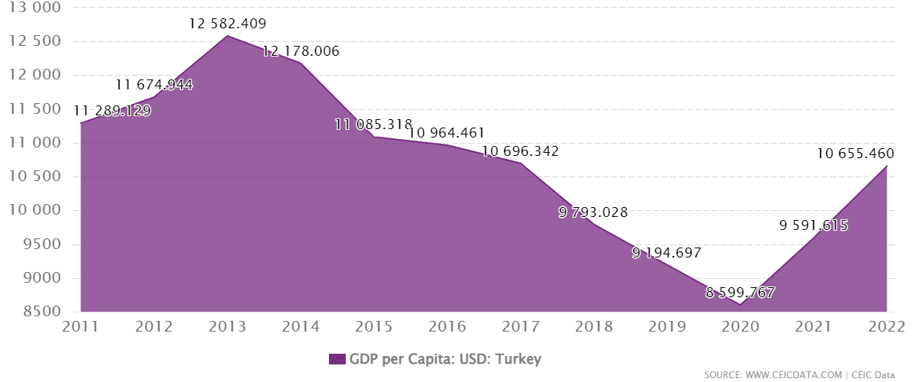
Turkey GDP per capita in US Dollars

Slide 27
Sources of long-term economic growth for Turkey, 1880 – 2005. Sumru Altuğ, Alpay Filiztekin and Şevket Pamuk
Another study, another estimate

Slide 28
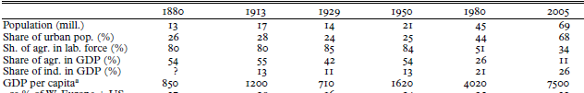
This is from “Sources of long-term economic growth for Turkey, 1880– 2005” by Sumru Altuğ, Alpay Filiztekin, and Şevket Pamuk
The long run average growth rate of per capita GDP is about 3.2%
The long run average growth rate of per capita GDP is 3.2%.
GDP per capita is PPP adjusted in 1990 US dollars.
Sources of long-term economic growth for Turkey, 1880 – 2005. SUMRU ALTUG, ALPAY FILIZTEKIN and ŞEVKET PAMUK. European Review of Economic History / Volume 12 / Issue 03 / December 2008, pp 393 430

Slide 29
Impact of higher GDP per capita on people’s lives
TURKEY

Slide 30
Life expectancy at birth
Hacettepe Universitesi Nufus Etutleri Enstitusu Türkiye’nin Demografik Dönüşümü: Doğurganlık, Aile Planlaması, Anne‐Çocuk Sağlığı ve Beş Yaş Altı Ölümlerdeki Değişimler: 1968‐2008

Slide 31
Literacy (age 6+)

Slide 32
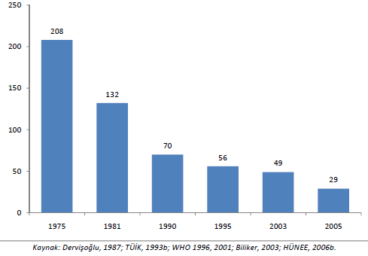
Maternal mortality per 100,000 birth 1975 - 2005

Slide 33
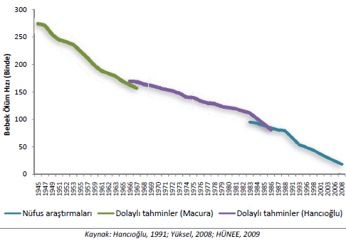
Infant mortality 1945 – 2008 (per thousands)

Slide 34
Turkey’s post 1960 growth performance relative to the world

Slide 35
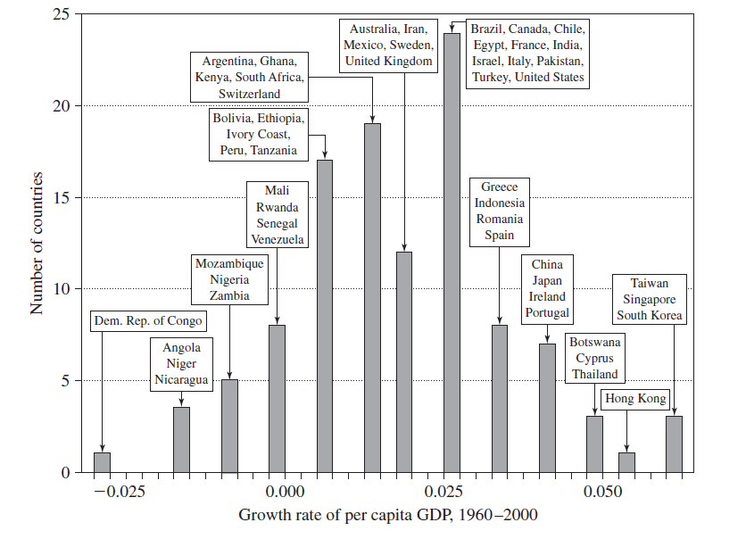
from “Economic Growth”, 2nd ed. by Robert Barro and Xavier Sala-i-Martin 2003 MIT Press

Slide 36
India, Brazil, China
Turkey’s growth performance relative to a number of selected countries

Slide 37
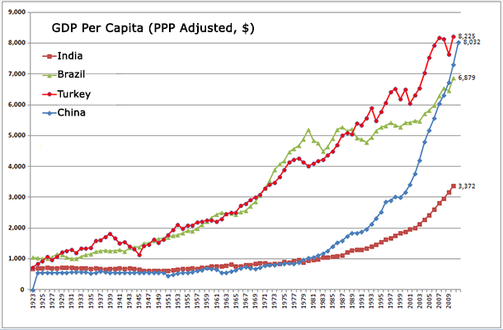
http://turkishmarketnews.com/story-90-years-two-charts/

Slide 38
World
Turkey against World

Slide 39
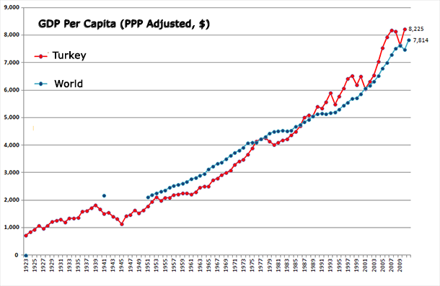
Turkey vs. The World

